Slide 1
Introduction
Attended Sprint Retrospectives Training – Derek’s presentation got me thinking
The Sprint is so central to what we do
T:\WebDev\PPPP\Retrospectives_Training.pptx
Agile Uprising Coalition – Derek credited them with suppling some visuals
Visuals and quotes were on point to what we do
https://coalition.agileuprising.com/
Events listed PhillyXP
https://www.meetup.com/PhillyXP/events
Local tech events with free food
Session on Ping Pong Pair Programming
Liked it so much just wanted to share with you
http://bit.ly/phillyxp-4p
Next Sprint

Slide 2
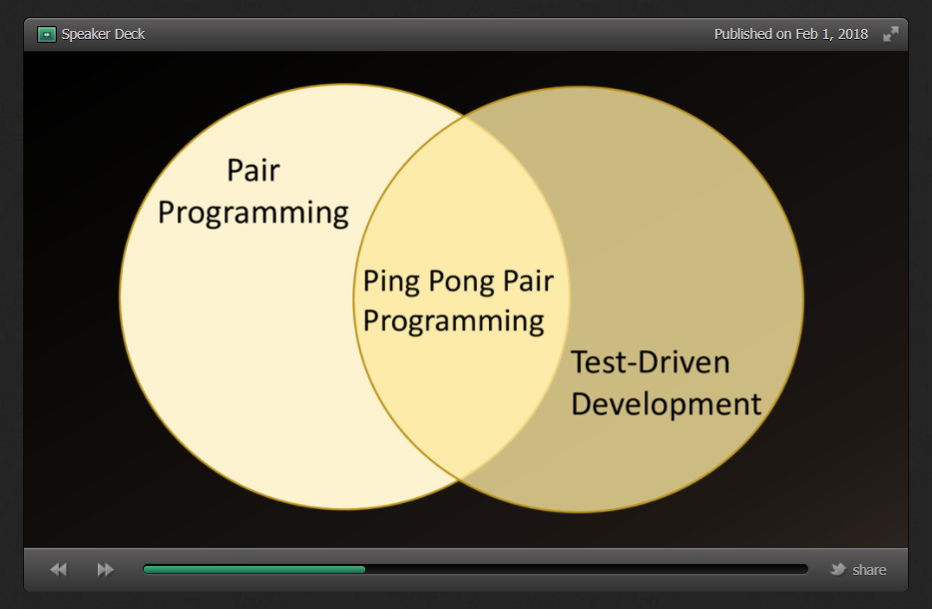
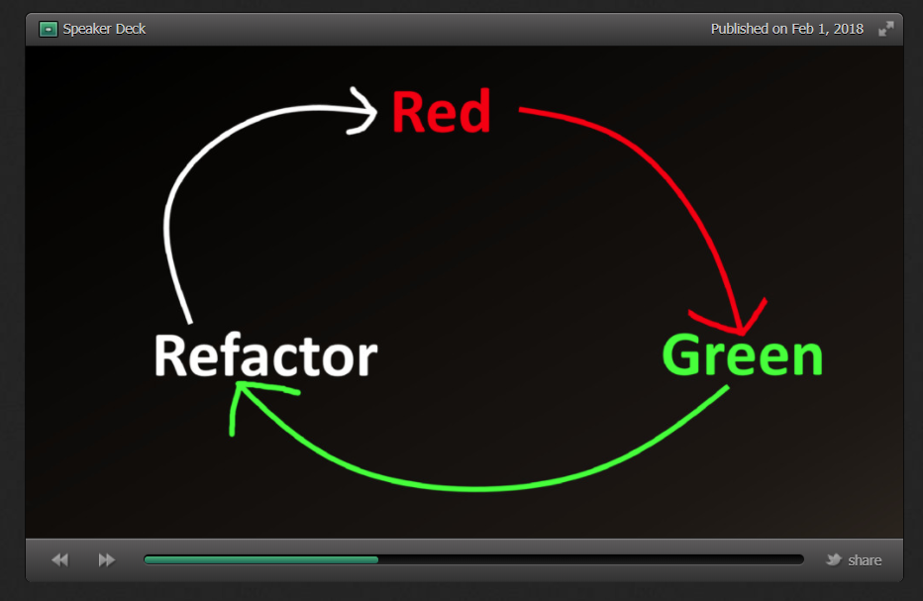
What is Ping Pong Pair Programming
A Style of Pair Programming
Designed to improve upon Traditional Pair Programming
Addresses Complaints:
I never get to type – my partner is a “Keyboard Dominator”
When I am typing - my partner is on their phone – “Disinterested Navigator”
Talking slows me down
Mismatched Pairs
Can’t get into the flow
Next Sprint
Unifies Pair Programming with Test-Driven Development
We all know Test-Driven Development
Start with creating a failing test
Write code to pass the test
Refactor and repeat

Slide 3
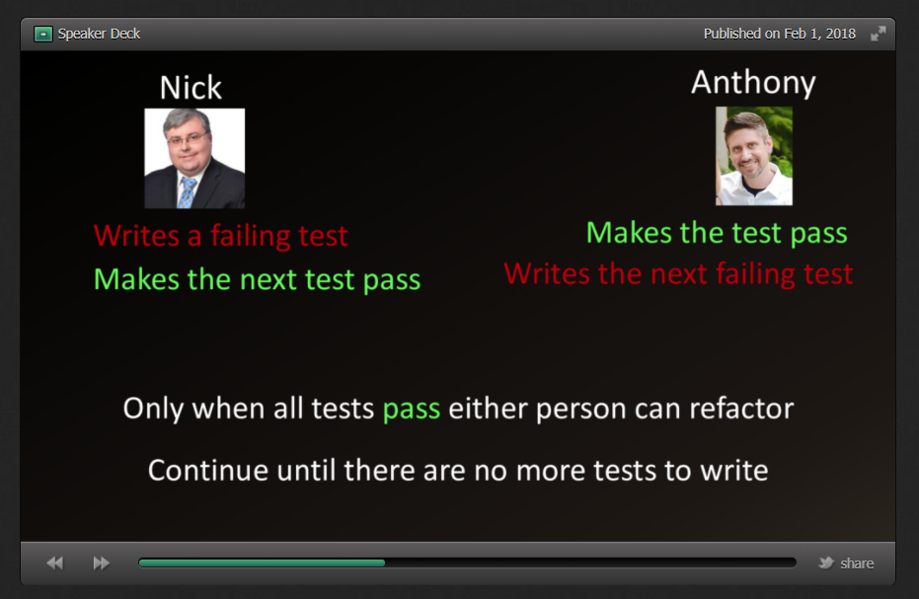
Ping Pong Pair Programming in Action
Next Sprint

Slide 4
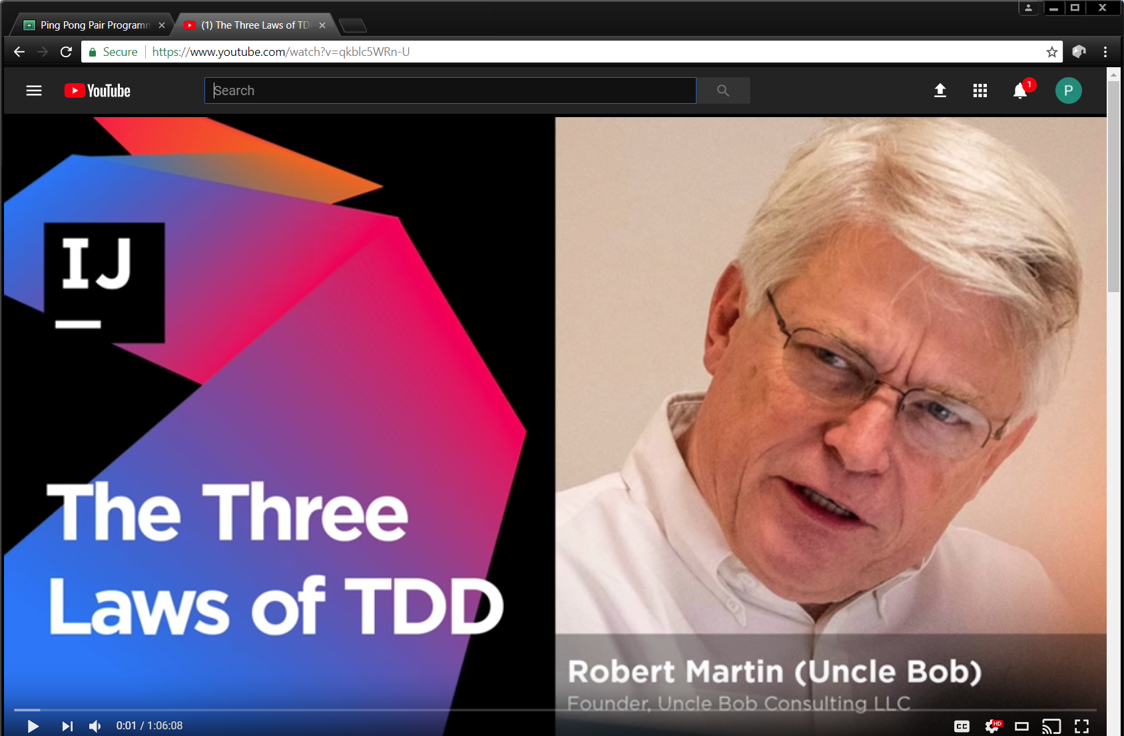
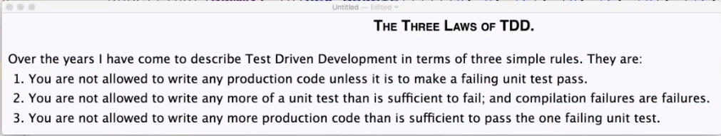
Test-Driven Development
Next Sprint

Slide 5
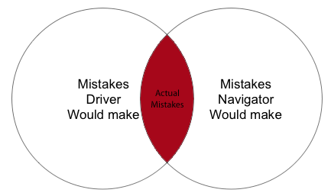
Benefits of Ping Pong Pair Programming
Benefits
Developer | Organization
Knowledge Sharing | Higher Velocity
Improved Readability | Shorter Onboarding
Develop Interpersonal Skills | Reduced Technical Debt
Receive Coaching | Reduced Bus Factor
Practice Coaching | Lower Costs
Moral support | Better Hiring
Next Sprint
“A problem shared, is a problem halved.”

Slide 6
Where KBRA is today
Pair-Programming:
We use Pair Programming 5 days in a month.
We should use Pair Programming 7 days in a month.
Test-Driven Development:
We use Test-Driven Development on 21 % of the time.
We should use Test-Driven Development on 50 % of the time
Next Sprint

Slide 7
Summary
Thank you Derek Parker:
Conducted awesome Retrospective Training.
Supplied slide deck from his training.
Thank you PhillyXP:
Conducted awesome MeetUp
Preliminary Presentation
Live Demo
Q&A with local Professionals
Provide free food and drinks
Next Sprint

